Slide 1
C ++ basic concepts

Slide 2
C++ What is OOP?
OOP stands for Object-Oriented Programming.
Procedural programming is about writing procedures or functions that perform operations on the data, while object-oriented programming is about creating objects that contain both data and functions.
Object-oriented programming has several advantages over procedural programming:
OOP is faster and easier to execute
OOP provides a clear structure for the programs
OOP helps to keep the C++ code DRY "Don't Repeat Yourself", and makes the code easier to maintain, modify and debug
OOP makes it possible to create full reusable applications with less code and shorter development time

Slide 3
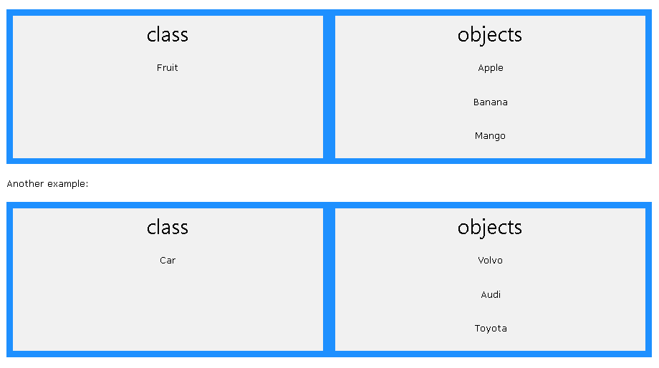
What are Classes and Objects?
Classes and objects are the two main aspects of object-oriented programming.
Look at the following illustration to see the difference between class and objects:
So, a class is a template for objects, and an object is an instance of a class.
When the individual objects are created, they inherit all the variables and functions from the class.

Slide 4
C++ Classes/Objects
C++ is an object-oriented programming language.
Everything in C++ is associated with classes and objects, along with its attributes and methods. For example: in real life, a car is an object. The car has attributes, such as weight and color, and methods, such as drive and brake.
Attributes and methods are basically variables and functions that belongs to the class. These are often referred to as "class members".
A class is a user-defined data type that we can use in our program, and it works as an object constructor, or a "blueprint" for creating objects

Slide 5
To create the class we use “classs” keyword
class mca { // The class public: // Access specifier int rollno; // Attribute (int variable) string name; // Attribute (string variable) };

Slide 6
Create an Object
In C++, an object is created from a class. We have already created the class named mca, so now we can use this to create objects.
To create an object of mca, specify the class name, followed by the object name.
To access the class attributes (name and rollno), use the dot syntax (.) on the object

Slide 7
class mca { // The class public: // Access specifier int rollno; // Attribute (int variable) string name; // Attribute (string variable) }; int main() { mca obj; // Create an object of MyClass // Access attributes and set values Obj.rollno= 15; obj.name = “yasir"; // Print attribute values cout << obj.name << "\n"; cout << obj.rollno; }

